Slide 1
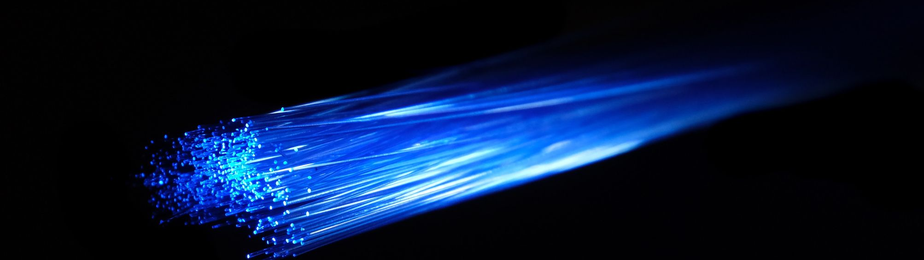
Silver
AIIJC team

Slide 2

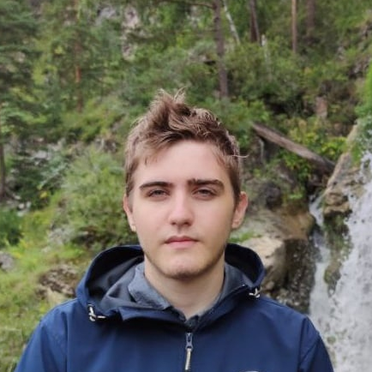
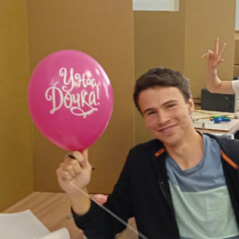
Team
Miskovets Georgii
Knyazhitskiy Roman
Shiryaev Dmitriy
Participant
AI engineer
Captain
Programmer; Data scientist
Participant
UI designer

Slide 3
Analyze
Problems of current SOTA
Using OpenPose with discussable accuracy and performance
Huge and slow ensembles
Using graph representation of palms

Slide 4


Solution
Use YOLO hand detector
Use single model
There are no problems with OpenPose, and it is much faster
Huge speedup

Slide 5
Analyze
Data set problems
Test set completely different from train/val sets
Train/val sometimes has 2/3 classes per video
Slow website, so huge delays when loading data set

Slide 6


Trade offs
Accuracy/Performance
Time consumption/Result
Use of ensembles
Use of light models
Suitable FPS
Fix data set by hands

Slide 7


Solution
Use part of test set while training
Use prepared data from Google Drive
Allows to ignore inconsistency of data

Slide 8



Steps
YOLOv5m to detect hands
CNN to compress images into latent space
BiLSTM to process entire videos

Slide 9


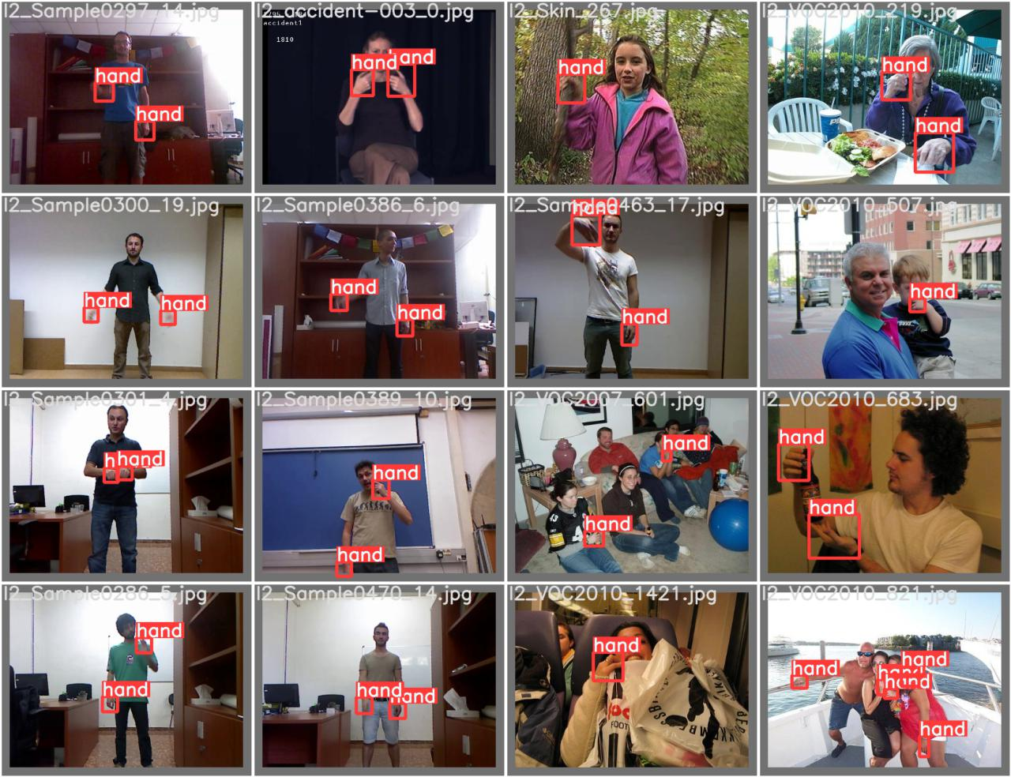
YOLO
mAP 0.5
0.97
mAP 0.5:0.95
0.63
Precision
0.97
Recall
0.94

Slide 10


Single image model
Train accuracy
0.446
Validation accuracy
0.452
Test accuracy
0.225

Slide 11


Final model - BiLSTM
Train accuracy
0.94
Validation accuracy
0.91
Raw test accuracy
0.55
Test accuracy with 25% of test data
0.97

Slide 12
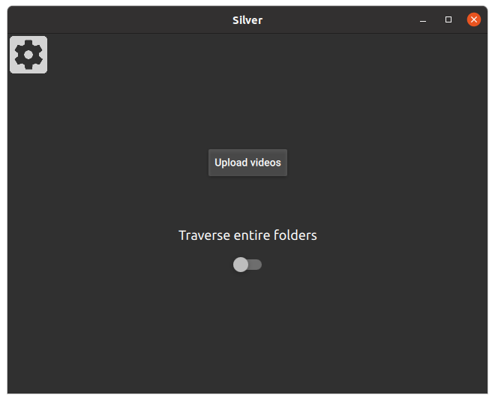
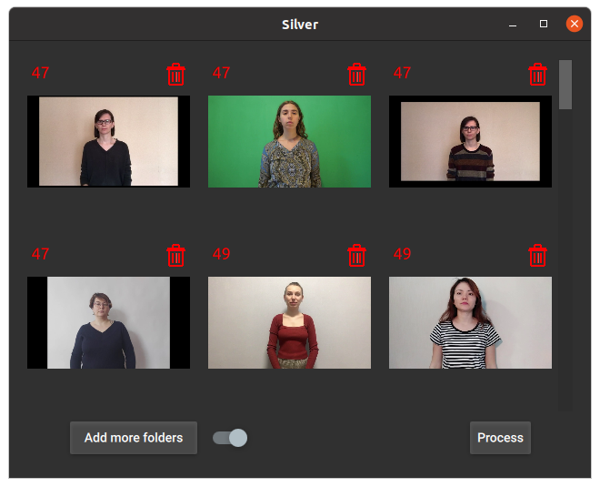
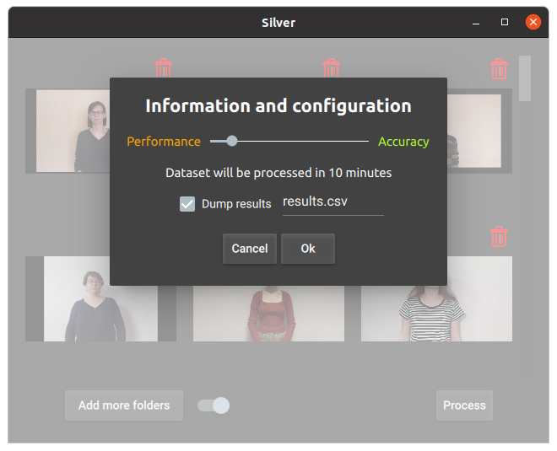
User Interface
PyQT5 + QML

Slide 13


Fast new classes addition
in progress
Dimensionality reduction
Clustering

Slide 14
The end

